Slide 1
Chapter 1 The Fundamentals: Logic and Proofs
Section 6
Rules of Inference推理规则

Slide 2
Outline
Introduction to Rules of Inference
Rules of Inference in Propositional Logic
Fallacies
Rules of Inference in Quantified Statements

Slide 3
Argument and inference
Argument (论证)
  A sequence of statements that end with a conclusion
  It may be valid or invalid
Valid
  The conclusion or final statement of the argument must follow the truth of proceeding statements or premise of the argument
  Premises is the statements whose truths have been established
  Conclusion is the statement whose truth is to be established
Proof (证明)
  valid arguments that establish the truth of a mathematical statement

Slide 4
Argument and inference
Argument (论证)
  是指表示一连串的命题最终得出结论
  It may be valid or invalid
Valid
  是计划得出结论或者论证的最终命题，其过程必须依据前面命题或者论证的前提的真实性
  也就是说，一个论证是真实的，当且仅当它对所有的前提为真而结论为假是不可能的
Proof (证明)
  valid arguments that establish the truth of a mathematical statement

Slide 5
Argument and inference
Remark
  An argument is valid if and only if it is impossible for all the premises to be true and the conclusion to be false
  Rules of inference (推理规则) are used to deduce new statements from statements that we already have (i.e., to construct valid argument)
  Rules of inference are basic tools for establishing the truth of statements

Slide 6
Valid arguments in propositional logic
Example
  Consider the following arguments involving propositions
    “If you have a correct password, then you can log onto the network” - premise
    “You have a correct password” - premise
    Therefore,
    “You can log onto the network” - conclusion

Slide 7
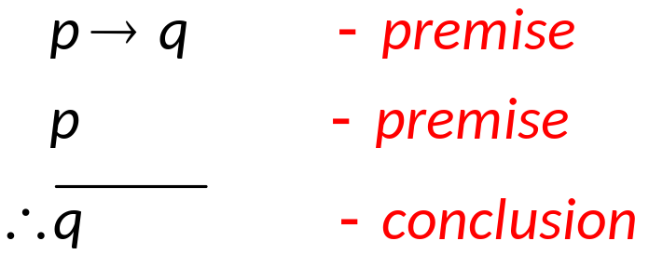
Valid arguments in propositional logic
  Translate into the form of logic expressions
    Let p: “You have a correct password”
    Let q: “You can log onto the network”
  The argument may be shown as the form
  For convenience, It may be written as
  (p → q) ∧ p |→ q

Slide 8
Valid arguments in propositional logic
Argument form (论证形式)
  An argument form in propositional logic is a sequence of compound propositions involving propositional variables
  It is valid when all the premises to be true implies the conclusion has to be true

Slide 9
Valid arguments in propositional logic
Example
  Is the above argument form (on page 6) valid?
    It is easy to know that (p → q) ∧ p → q is a tautology
    When both p → q and p are true, ((p → q) ∧ p) is true, and thus q must be also be true
    So this form of argument is valid because when the premises are all true, the conclusion must be true
The valid argument form
  The argument form with premises ϕ₁, ϕ₂, …, ϕ_{n} and conclusion ψ is valid when
  (ϕ₁ ∧ ϕ₂ ∧ … ∧ ϕ_{n}) →ψ
  is a tautology. Here ϕ₁, ϕ₂, …, ϕ_{n} and ψ can be primitive or compound propositions.

Slide 10
Valid arguments in propositional logic
Example
  If you have access to the network, then you can change your grade. Now You have access to the network, so You can change your grade.
    p: “You have access to the network”
    q: “You can change your grade”
    p→q: “If you have access to the network, then you can change your grade”
  It is the form of (p → q) ∧ p |→ q and is valid. The conclusion is not very correct because the first premise is not always true.

Slide 11
Rules of inference for propositional logic
Rules of inference (推理规则)
  Truth table can always be used to show that an argument form is valid (why?)
  For an argument form with n propositional variables, the truth table requires 2^{n} rows
  Rules of inference are relatively simple argument forms whose validity have been established
  By making use of Rules of inference, we construct valid argument forms step by step, trying to find out the conclusion

Slide 12
Rules of inference for propositional logic
Example
  The tautology (p → q) ∧ p → q is one of the rules of inference called modus ponens (mode that affirms), or the law of detachment (分离规则)
    If both statements “If it snows today, then we will go skiing” and “It is snowing today” are true.
    By modus ponens, it follows the conclusion “We will go skinning” is true

Slide 13
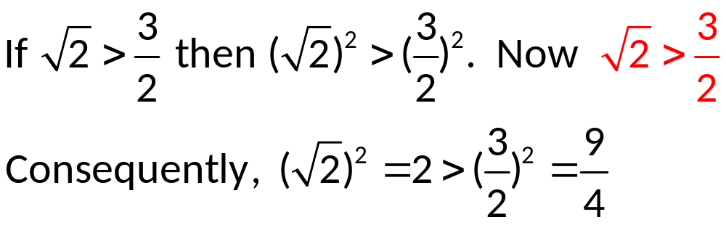
Rules of inference for propositional logic
Example
  The argument is valid by using modus ponens
  But one of the premises is false, consequently we cannot conclude that the conclusion is true
  Furthermore, the conclusion is not true
Remark
  We may get a wrong conclusion by making use of a valid argument with a wrong premise

Slide 14
Rules of inference for propositional logic
Some important Rules of Inference
  (p ∧ (p → q)) → q Modus ponens 分离规则
  (¬q ∧ (p → q)) → ¬p Modus tollens 拒取式
  ((p → q) ∧ (q → r)) → (p → r) Hypothetical syllogism
  假言三段论
  ((p ∨ q) ∧ ¬p) → q Disjunctive syllogism
  析取三段论
  p → (p ∨ q) Addition 附加律
  (p ∧ q) → p Simplification 化简律
  ((p) ∧ (q)) → (p ∧ q) Conjunction 合取律
  ((p ∨ q) ∧ (¬p ∨ r)) → (q ∨ r) Resolution
  消去律/消解律/归结规则

Slide 15
Rules of inference for propositional logic
Example
  Addition rule (附加律)
    “It is below freezing now.”
    Therefore, “It is either below freezing or raining now.”
Example
  Simplification rule (化简律)
    “It is below freezing and raining now.”
    Therefore, “It is below freezing now.”

Slide 16
Rules of inference for propositional logic
Example
  Hypothetical Syllogism (假言三段论)
    “If it rains today, then we will not have a barbecue today.”
    “If we have not a barbecue today, then we will have a barbecue tomorrow.”
    Therefore, “If it rains today, then we will have a barbecue tomorrow.”
    若今天下雨，则我们今天将不野餐
    若我们今天不野餐，则我们明天将野餐
    因此，若今天下雨。则我们明天将野餐。

Slide 17
Rules of inference for propositional logic
Example
  Show that the hypotheses
    “It is not sunny this afternoon and it is colder than yesterday”
    “We will go swimming only if it is sunny”
    “If we do not go swimming, then we will take a canoe trip”
    “If we take a canoe trip, then we will be home by sunset”
  Lead to the conclusion
    “We will be home by sunset”
    今天下午没有出太阳并且今天比昨天冷，
    只有今天下午出太阳，我们才去游泳，
    若我们不去游泳，则我们将乘独木舟游览,
    若我们乘独木舟游览，则我们将在黄昏时回家
    导致结论“我们将在黄昏时回家”。

Slide 18
Rules of inference for propositional logic
  Solution
    Let
      p: “It is sunny”
      q: “it is colder than yesterday”
      r: “We go swimming”
      s: “we will take a canoe trip”
      t: “we will be home by sunset”
    We have the following hypotheses as premises
      ¬p ∧ q, r → p, ¬r → s, s → t
    and t as conclusion
    今天下午没有出太阳并且今天比昨天冷，
    只有今天下午出太阳，我们才去游泳，
    若我们不去游泳，则我们将乘独木舟游览,
    若我们乘独木舟游览，则我们将在黄昏时回家
    导致结论“我们将在黄昏时回家”。

Slide 19
Rules of inference for propositional logic
    The argument being constructed as
  Step Reason
      ¬p ∧ q Hypothesis
      ¬p Simplification using (1)
      r → p Hypothesis
      ¬r Modus tollens using (2) and (3)
      ¬r → s Hypothesis
      s Modus ponens using (4) and (5)
      s → t Hypothesis
      t Modus ponens using (6) and (7)
    Note that the truth table for the argument would get 2⁵ = 32 lows

Slide 20
Rules of inference for propositional logic
Example
  Show that the hypotheses
    “If you send me an email message, then I will finish my program”
    “If you do not send me an email message, then I will go to sleep early”
    “If I go to sleep early, then I will wake up feeling refreshed”
  Lead to the conclusion
    “If I do not finish writing the program, then I will wake up feeling refreshed”

Slide 21
Rules of inference for propositional logic
  Solution
    Let
      p: “you send me an email message”
      q: “I will finish my program”
      r: “I will go to sleep early”
      s: “I will wake up feeling refreshed”
    We have the following hypotheses as premises
      p → q, ¬p → r, r → s
    and ¬q → s as conclusion

Slide 22
Rules of inference for propositional logic
    The argument being constructed as
    Step Reason
      p → q Hypothesis
      ¬q → ¬p Contrapositive of (1)
      ¬p → r Hypothesis
      ¬q → r (2)(5) Hypothetical syllogism
      r → s Hypothesis
      ¬q → s (4)(5) Hypothetical syllogism

Slide 23
Resolution
Resolution (归结)
  The resolution rule is based on the tautology
((p ∨ q) ∧ (¬p ∨ r)) → (q ∨ r)
  The conclusion, say (q ∨ r), is called the Resolvent (消去式/归结式) of the two clauses (子句), say (p ∨ q) and (¬p ∨ r)
  Let r = q, we have ((p ∨ q) ∧ (¬p ∨ q)) → q
  Let r = False, we have ((p ∨ q) ∧ ¬p) → q
  Resolution is important in logic programming, AI, etc.

Slide 24
Resolution
Example
  Show that the hypotheses
    “Jasmine is skiing or it is not snowing”
    “It is snowing or Bart is playing hockey”
  imply that
    “Jasmine is skiing or Bart is playing hockey”

Slide 25
Resolution
  Solution
    Let
      p: “Jasmine is skiing”
      q: “It is snowing”
      r: “Bart is playing hockey”
    We have the following two hypotheses as premises
      q ∨ ¬p, p ∨ r
    and q ∨ r as conclusion
    It is easy to construct the valid argument by applying the resolution rule once on the two hypotheses to get the conclusion

Slide 26
Resolution
Remark
  To construct proofs using resolution as the only rule of inference, the hypotheses and the conclusion must be expressed as clauses
Literal (文字)
  A literal is a propositional variable or the negation of a propositional variable such as p, ¬q, … . Two literals are said to be complements if one is the negation of the other
    e.g., p and ¬p are complements
Clause (子句)
  A clause is a finite disjunction of literals
  Making use of logical equivalences, any propositional wff can be changed to the form of CNF (合取范式)
  De Morgan’s law is commonly used

Slide 27
Resolution
Example
  show that ((p ∧ q) ∨ r) and (r → s) imply (p ∨ s)
  Solution
    ((p ∧ q) ∨ r) ≡ (p ∨ r) ∧ (q ∨ r)
    (r → s) ≡ ¬r ∨ s
    The premises as p ∨ r, q ∨ r and ¬r ∨ s
    Applying the resolution rule on p ∨ r and ¬r ∨ s to get the conclusion p ∨ s

Slide 28
Resolution
*Prove by resolution
*Resolution refutation (归结反演)

Slide 29
Fallacies
Remark
  Several common fallacies arise in incorrect arguments, based on contingencies rather than tautologies
Fallacy of affirming the conclusion (肯定结论)
  (p → q) ∧ q → p is not a tautology as it is false when p is false and q is true
  Example
    If you do every problem in this book, then you will learn discrete mathematics. Now you learned discrete mathematics, therefore you did every problem in this book
    若你做本书的每一道练习，则你将学习离散数学。你学习过离散数学。因此，你做过本书的每一道练习。

Slide 30
Fallacies
Fallacy of denying the hypothesis (否定前提)
  (p → q) ∧ ¬p → ¬q is not a tautology as it is false when p is false and q is true
  Example
    If you do every problem in this book, then you will learn discrete mathematics. Now you did not do every problem in this book, therefore you did not learn discrete mathematics

Slide 31
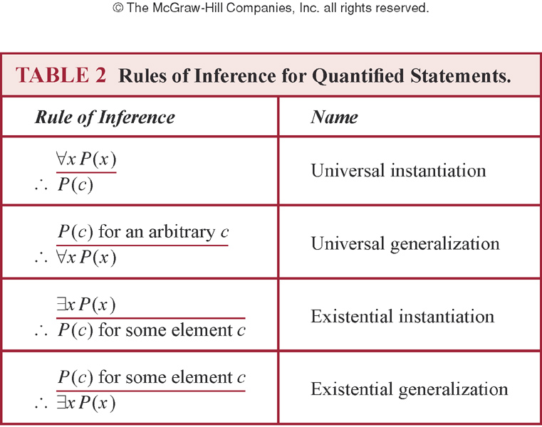
Inference with quantified statements

Slide 32
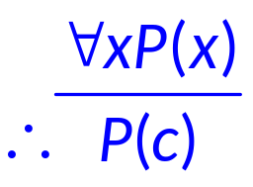
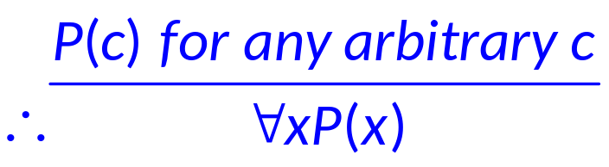
Inference with quantified statements
Universal Instantiation
  全称量词例化/消去, UI规则
  Let c be one particular member of the domain
Universal Generalization
  全称量词生成/引入, UG 规则
  For any arbitrary member c

Slide 33
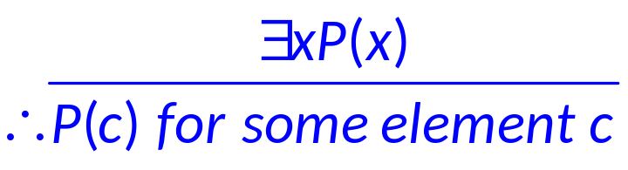
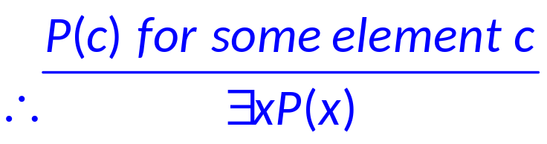
Inference with quantified statements
Existential Instantiation
  存在量词例化/消去, EI 规则
  We have no knowledge or it is unnecessary to know what c is, only that it exists
Existential Generalization
  存在量词生成/引入, EG 规则
  When we know a particular element c with P(c) is true

Slide 34
Inference with quantified statements
Example
  “Everyone in this discrete mathematics class has taken a course in computer science” and “Marla is a student in this class” imply “Marla has taken a course in computer science”
  Solution
    Let
      D(x): “x is in this discrete mathematics class”
      C(x): “x has taken a course in computer science”
    We have the following two hypotheses as premises
      ∀x(D(x) → C(x)), D(Marla)
    and C(Marla) as the conclusion

Slide 35
Inference with quantified statements
    The argument being constructed as
    Step Reason
      ∀x(D(x) → C(x) Premise
      D(Marla) → C(Marla) UI from (1)
      D(Marla) Premise
      C(Marla) Modus ponens using (2)(3)

Slide 36
Inference with quantified statements
Example
  “A student in this class has not read the book”, and “Everyone in this class passed the first exam” imply “Someone who passed the first exam has not read the book”
  Solution
    Let
      C(x): “x is in this class”
      B(x): “x has read the book”
      P(x): “x passed the first exam”
    We have the following two hypotheses as premises
      ∃x(C(x) ∧ ¬B(x)), ∀x(C(x) → P(x))
    and ∃x(P(x) ∧ ¬B(x)) as the conclusion

Slide 37
Inference with quantified statements
    The argument being constructed as
    Step Reason
      ∃x(C(x) ∧ ¬B(x)) Premise
      C(a) ∧ ¬B(a) EI from (1)
      C(a) Simplification from (2)
      ∀x(C(x) → P(x)) Premise
      C(a) → P(a) UI from (4)
      P(a) Modus ponens using (3)(5)
      ¬B(a) Simplification from (2)
      P(a) ∧ ¬B(a) Conjunction of (6)(7)
      ∃x(P(x) ∧ ¬B(x)) EG from (8)

Slide 38
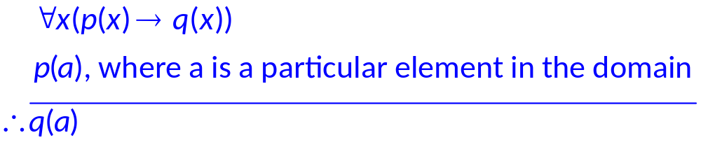
Universal modus ponens
Remark
  Use universal instantiation and modus ponens to derive new rule
Example
  Assume “For all positive integers n, if n is greater than 4, then n² is less than 2^{n}” is true. Show 100²<2¹⁰⁰

Slide 39
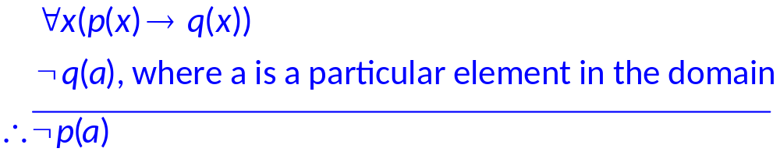
Universal modus tollens
Remark
  Combine universal modus tollens and universal instantiation

Slide 40
Rules of inference for predicates
Some Important Rules of Inference
  (∀x)P(x) ∨ (∀x)Q(x) → (∀x)(P(x) ∨ Q(x))
  (∃x)(P(x) ∧ Q(x)) → (∃x)P(x) ∧ (∃x)Q(x)
  (∀x)(P(x) → Q(x)) → (∀x)P(x) → (∀x)Q(x)
  (∀x)(P(x) → Q(x)) → (∃x)P(x) → (∃x)Q(x)
  (∀x)(∀y)P(x, y) → (∃y)(∀x)P(x, y)
  (∃x)(∀y)P(x, y) → (∀y)(∃x)P(x, y)
  (∀x)(∃y)P(x, y) → (∃x)(∃y)P(x, y)

Slide 41
Rules of inference for predicates
Example
  Show that
  (∃x)P(x)→(∀x)(P(x)∨Q(x)→R(x)), (∃x)P(x) imply (∃x)(∃y)(R(x)∧R(y))
  Solution

Slide 42
Rules of inference for predicates
(∃x)P(x)→(∀x)(P(x)∨Q(x)→R(x)) Premise
(∃x)P(x) Premise
(∀x)(P(x)∨Q(x)→R(x)) (1)(2) Modus ponens
P(c) (2) EI
P(c)∨Q(c) (4) Addition
P(c)∨Q(c)→R(c) (3) UI
R(c) (5)(6) Modus ponens
(∃x)R(x) (7) EG
(∃y)R(y) (7) EG
(∃x)R(x)∧(∃y)R(y) (8)(9) Conjunction
(∃x)(R(x)∧(∃y)R(y)) (10) R2
(∃x)(∃y)(R(x)∧R(y)) (11) Equivalence
Element c was selected by (4)

Slide 43
Rules of inference for predicates
Example
  Let P(x, y): x > y , Premise as (∀x)(∃y)P(x, y). What’s wrong with the following argument?
(1) (∀x)(∃y)P(x, y) Premise
(2) (∃y)P(z, y) (1) UI
(3) P(z, b) (2) EI
(4) (∀z)P(z, b) (3) UG
(5) P(b, b) (4) UI
So that b > b

Slide 44
Rules of inference for predicates
  Solution
    Consider the premise (∀x)(∃y)P(x, y), ∃y is within the scope of ∀x. The existence of y depends on element x (Skolem’s dependence), or y= f_{Skolem}(x). Thus in line(3), we have b = f_{Skolem}(z)
    The argument should be as：
    (1) (∀x)(∃y)P(x, y)
    (2) (∀x)P(x, f_{Skolem}(x))
    (3) P(b, f_{Skolem}(b))

Slide 45
Assignment
Assignment after 1.6: 14, 24

Slide 46
Exercises 14.
For each of these arguments, explain which rules of inference are used for each step.
a) “Linda, a student in this class, owns a red convertible. Everyone who owns a red convertible has gotten at least one speeding ticket. Therefore, someone in this class has gotten a speeding ticket.
Solution
Let P(x): x in this class
Let Q(x): x owns a red convertible
Let L(x): x has gotten at least one speeding ticket
    We have the following three hypotheses as premises
      P(Linda),Q(Linda), ∀x(Q(x) → L(x))
    and ∃x(P(x ∧ L(x)) as the conclusion

Slide 47
Exercises 14.
For each of these arguments, explain which rules of inference are used for each step.
b) “Each of five roommates, Melissa, Aaron, Ralph, Veneesha, and Keeshawn, has taken a course in discrete mathematics. Every student who has taken a course in discrete mathematics can take a course in algorithms. Therefore, all five roommates can take a course in algorithms next year.”
Solution
Let P(x): x is roommate
Let Q(x): x has taken a course in discrete mathematics
Let L(x): x can take a course in algorithms
We have the following two hypotheses as premises
      ∀x(P(x) ∧ Q(x)), ∀x(Q(x) → L(x))
    and ∀ x(P(x) → L(x)) as the conclusion

Slide 48
Exercises 14.
For each of these arguments, explain which rules of inference are used for each step.
c) “All movies produced by John Sayles are wonderful. John Sayles produced a movie about coal miners. Therefore, there is a wonderful movie about coal miners.”
Solution
Let P(x): x movies produced by John Sayles
Let Q(x): x is wonderful
Let L(x): x is movie about coal miners
    We have the following three hypotheses as premises
      ∀x(P(x) → Q(x)), ∃x(P(x) ∧ L(x) )
    and ∃x(Q(x) ∧L(x)) as the conclusion

Slide 49
Exercises 14.
For each of these arguments, explain which rules of inference are used for each step.
d) “There is someone in this class who has been to France. Everyone who goes to France visits the Louvre. Therefore, someone in this class has visited the Louvre.”
Solution
Let P(x): x in this class
Let Q(x): x has been to France
Let L(x): x visits the Louvre
    We have the following three hypotheses as premises
      ∃x(P(x) ∧ Q(x)), ∀x(Q(x) → L(x))
    and ∃x(P(x) ∧ L(x)) as the conclusion

Slide 50
Exercises 24.
Identify the error or errors in this argument that supposedly shows that if ∀x(P (x) ∨ Q(x)) is true then ∀xP (x) ∨ ∀xQ(x) is true.
1. ∀x(P (x) ∨ Q(x)) Premise
2. P (c) ∨ Q(c) Universal instantiation from (1)
3. P (c) Simplification from (2)
4. ∀xP (x) Universal generalization from (3)
5. Q(c) Simplification from (2)
6. ∀xQ(x) Universal generalization from (5)
7. ∀x P (x) ∨ ∀xQ(x)) Conjunction from (4) and (6)
Solution

